Slide 1

Chinese Pharmaceuticals
Demand Forecasting and Inventory Management Challenges

Slide 2

Agenda
Industry Analysis
Sales Forecasting
Forecasting Improvements
Recommendations

Slide 3




Importance of the drug
Around 1000 Retail Outlets for Distribution of Noto37
50% Deaths due to High Cholesterol Levels
40% Market Share in Chinese Herbal Medicines
95% Company’s Sales : Hong Kong Market

Slide 4
Industry Analysis : VRIN Framework
Resources | Value | Rareness | Imitability | Organization | Competitive Advantage
Inventory Management Strategy | Yes | No | Yes, Similar Strategies might be used by other firms. | Company Utilizes multiple deliveries every week to maximize capabilities | Competitive Parity
Customer Loyalty | Yes | Yes | Not Easy to imitate | Weekly marketing Campaigns & Local Celebrity Spokespersons promoting | Sustainable Competitive Advantage
Retail Network | Yes | Yes | Yes, Other companies might be able to imitate | There are around 1000 retail stores where Noto37 is available | Temporary Competitive Advantage
Raw Materials and Production | Yes | No | Yes, Similar Approaches | Takes total of 100 days for a drug to be ready for market | Competitive Parity

Slide 5
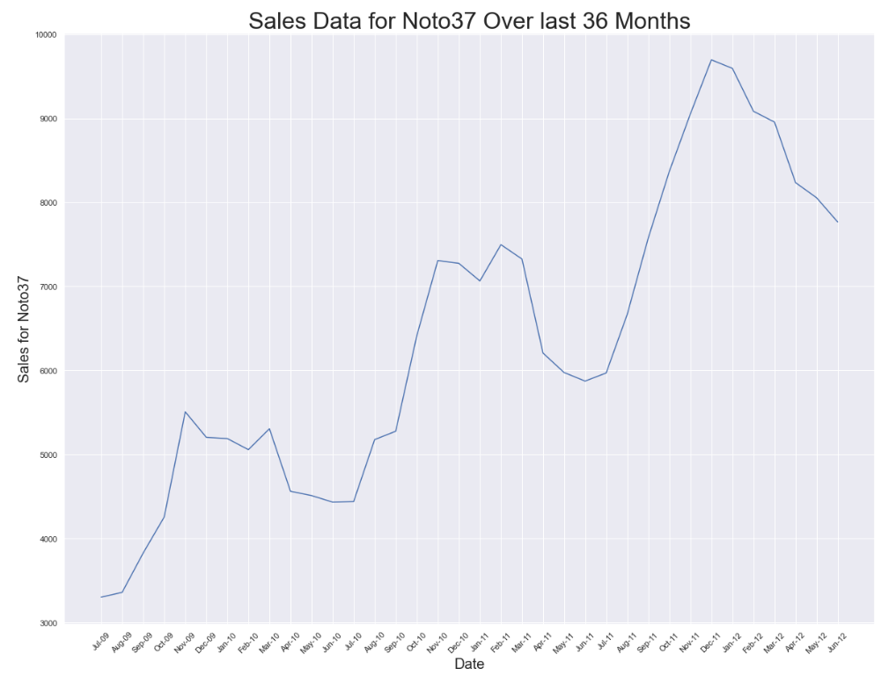
Sales forecasting
Winter Season observes Peak Sales.
Maximum monthly Sales in Dec 2011.
Gradual Increase in Sales for Noto37 year after year.

Slide 6
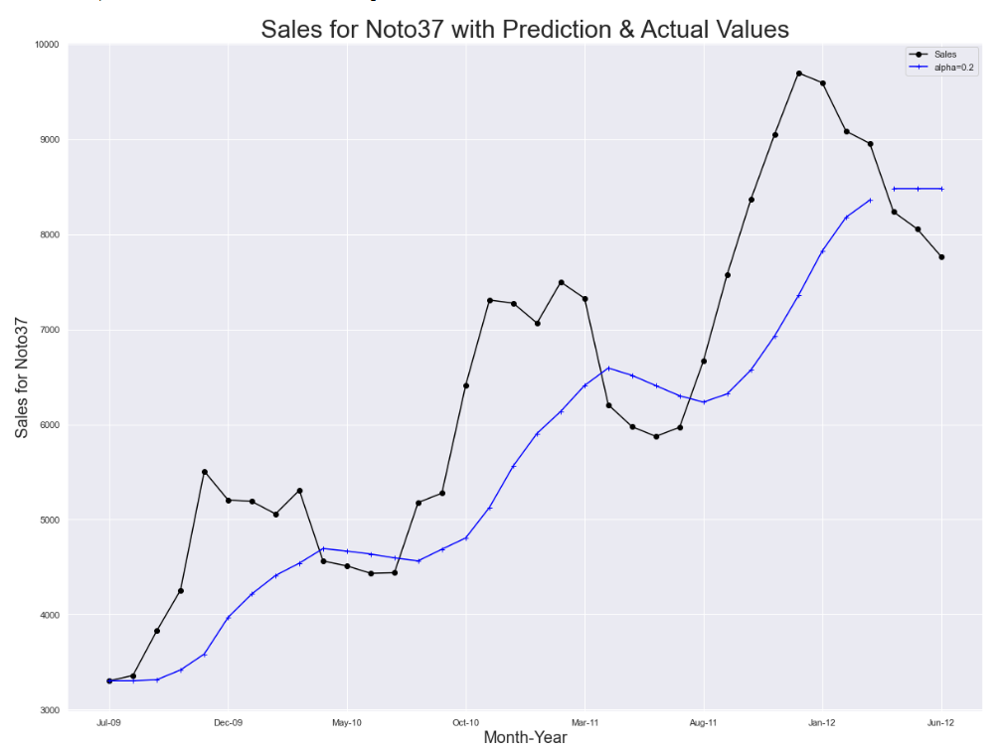
Simple Exponential Smoothing
Alpha = 0.2
Weighted Average based Forecasting.
SES does not encompass the Trend & Seasonality.
MAPE : 5.78%
RMSE : 497.72

Slide 7
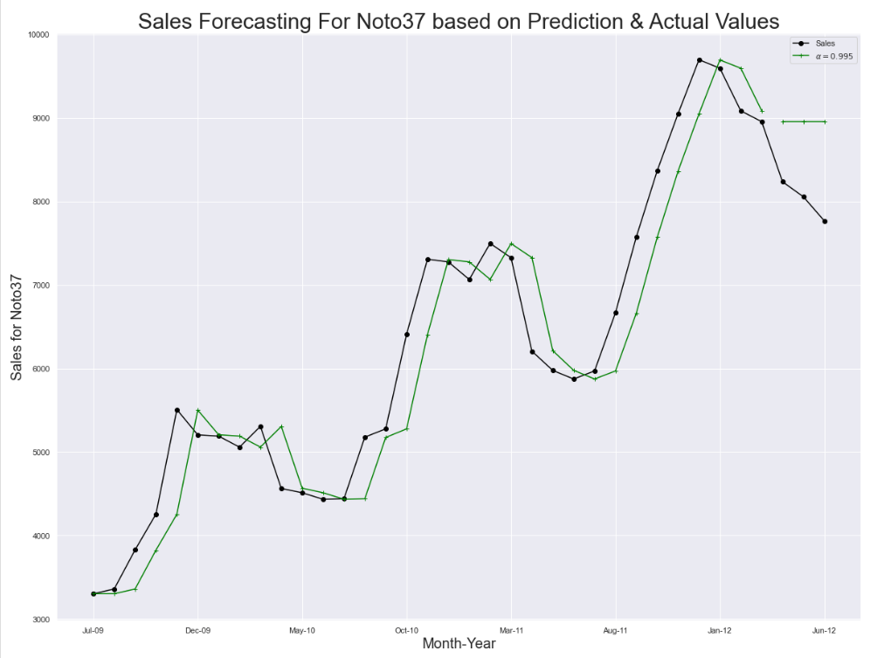
Simple Exponential Smoothing
Auto-optimized Fit automatically calculates the smoothing parameter.
Ideally this method gives the lowest error.
MAPE : 11.75%
RMSE : 956.28

Slide 8
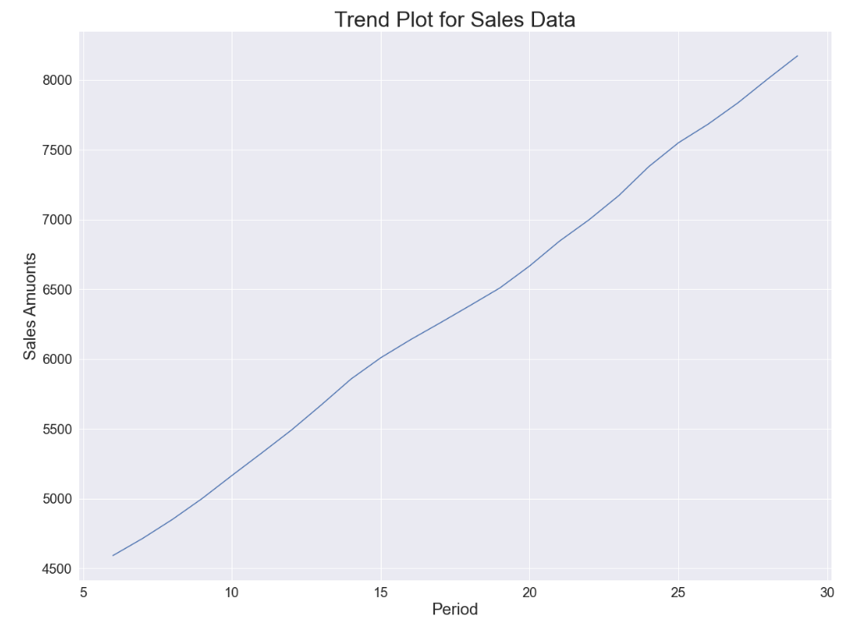
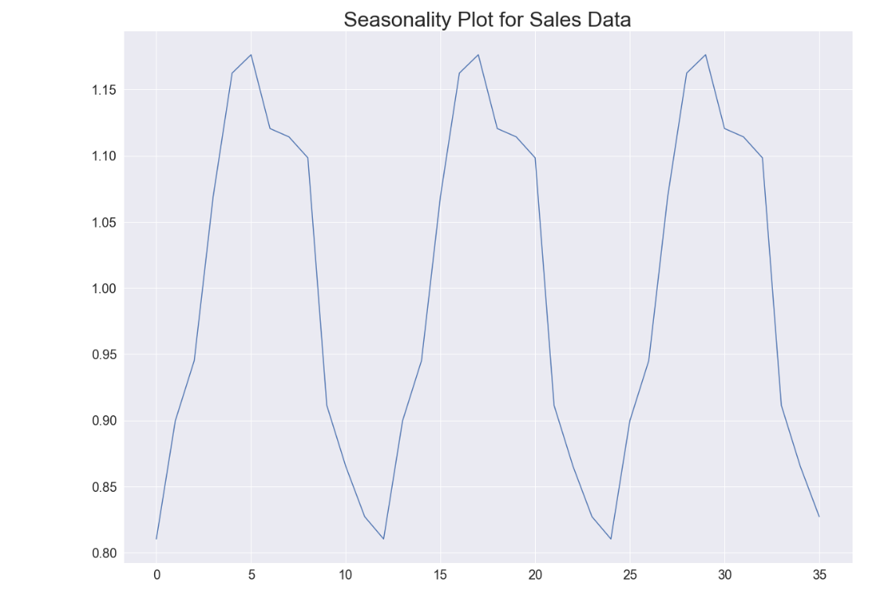
Trend & Seasonality OBSERVED between JULY 09 to June 12

Slide 9
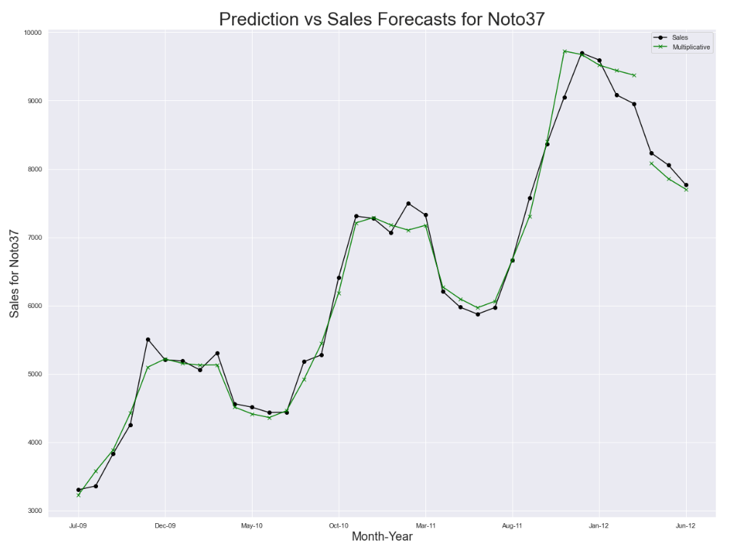
Holt Winters Seasonal Method
Additive Trends & Multiplicative Seasonality.
Captures Trend & Seasonality Appropriately.
MAPE : 1.72%
RMSE : 149.67

Slide 10
Recommendations
Utilize Better Demand Forecasting Techniques to Capture the Trend & Seasonality in Sales Data for most selling item.
Procure Additional Inventory Storage Locations for the Peak Sales (Winter) seasons.
Reduce Time to market for the Drug after acquiring the Raw Materials while maintaining quality.
Expand the Retail Network to increase market dominance by providing lucrative promotional offers.

Slide 11

Thank you

